Slide 2
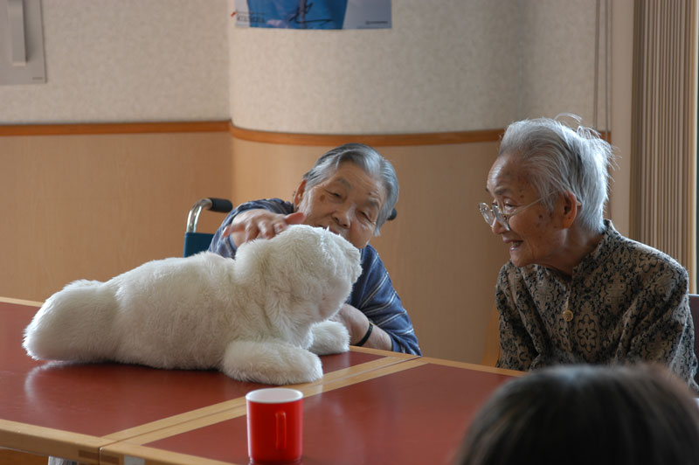
Robot therapy
Social robots provide therapy
Could help patients in a hospital
Help teach autistic children new skills.
May help diagnose autism earlier.

Slide 3
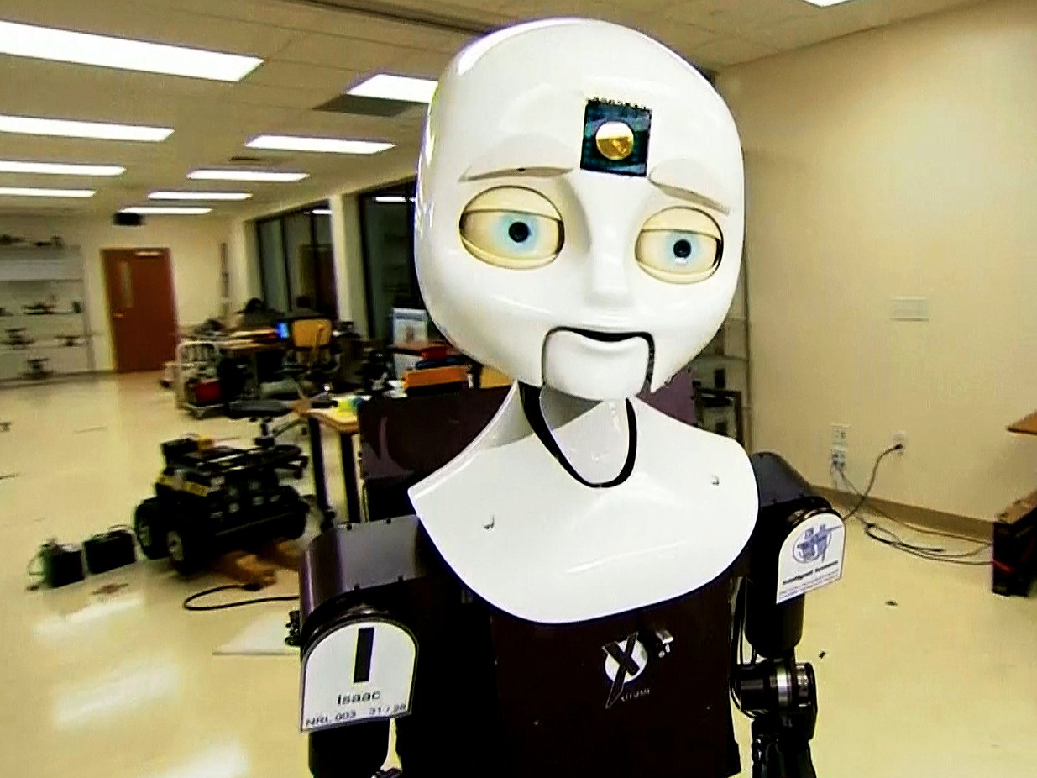
What are Social Robots?
An autonomous robot
Must have a physical embodiment.
Communicates and interacts with humans and embodied agents.

Slide 4
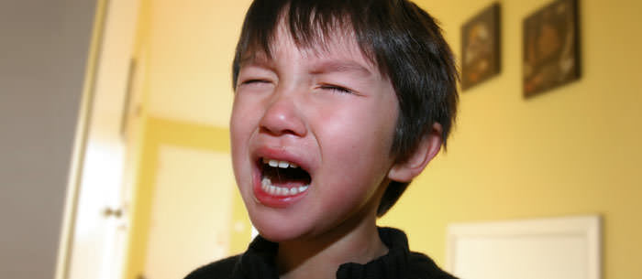
Autism
Lifelong, developmental disability
Affects how a person communicates with and relates to other people
A spectrum condition (affects in different ways)
Trouble communicating, looking people in the eye and standing loud noises or bright lights
Sensitivity to touch, tastes, smells and colours.
Order and predictability are preferred

Slide 5
Autism
Starts around the age of 3
The prevalence in 1943 was estimated at 1 in every 2,000 children
Today it is one out of every 68 children
More prevalent than breast cancer or childhood diabetes
The recurrence rate for having a second child with autism if one already exists within a family is 15-20%
4 times more common in boys than girls
25% of people diagnosed with it have nonverbal autism

Slide 6
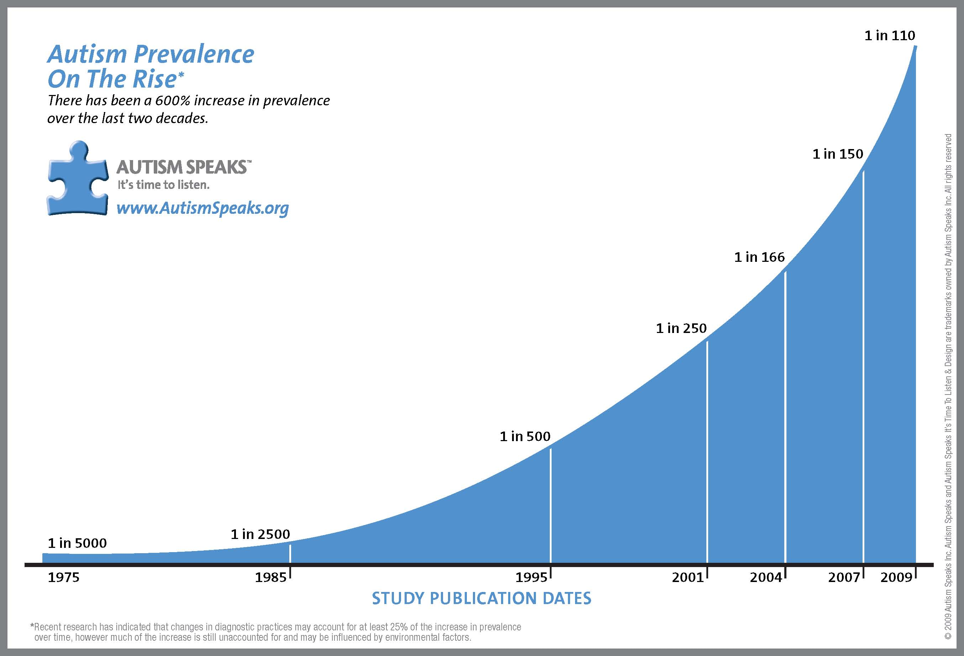

Slide 7
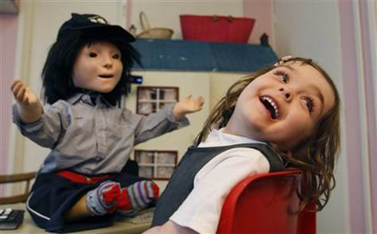
„The robots have no emotion, so autistic children find them less threatening than their teachers and easier to engage with.“
~ Ian Lowe, headteacher of the Topcliffe Primary School in
Castle Vale, Birmingham

Slide 8
Goals
When a child interacts with the robot, it is almost the same as interacting with a normal person to develop social behavior.
Teach children with ASD appropriate social responses
Create situations in which they can practice these skills
Help the children apply the social responses to interactions with the therapist, family and peers

Slide 9
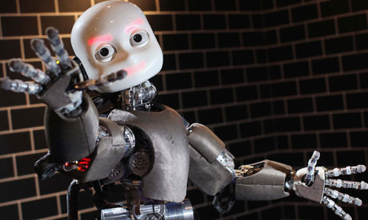
Robots4Autism

Slide 10
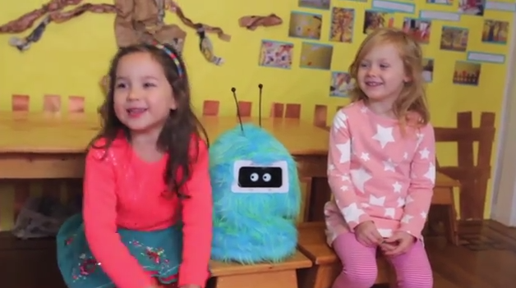
Romibo
At the Duck’s Nest preschool in Oakland, Calif., a fluffy blue robot asks a group of toddlers, “I want to be your friend. Will you please be my friend?”
Low-cost and affable robot (creator: Aubrey Shick)
“The robot is safe. The robot’s facial features don’t change,” says Laura McGuire
“There’s not so much to figure out with talking to a robot, where there was a lot to figure out in talking to a human being.”

Slide 11
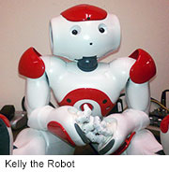
Kelly
In 2013 the University of Notre Dame published results from a study of 19 children with autism.
The talking robot, nicknamed Kelly, costed $14,000 .
It coach autistic children to make eye contact or take turns talking.
Kelly is a Nao “humanoid” robot.

Slide 12
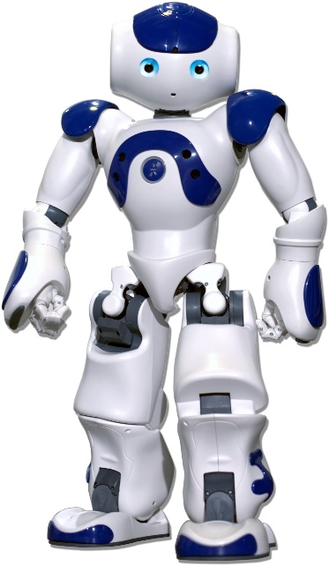
Nao
The leading humanoid robot being used in research and education worldwide
Every robot comes standard with Choregraphe
Has a series of verbal prompts and gestures (imitating human therapists)
Adapts its behavior to each child automatically

Slide 13
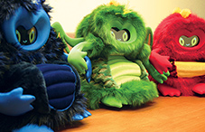
Bubblebot
The child has found resemblance in between the robot and his family or friends and has reacted to it.
The bubblebot was designed to help children social skills such:
Imitation
Taking turns
Maintaining joint attention with another person

Slide 14
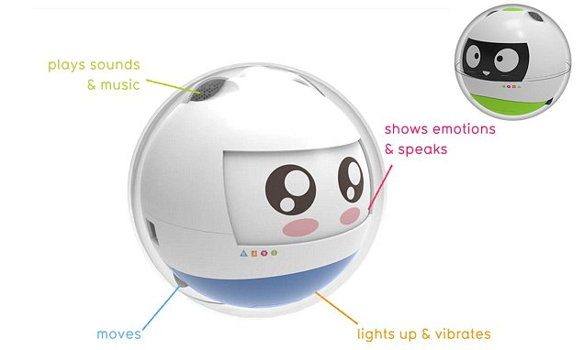
Leka
Designed specifically for people with ASD
Motion-sensitive bot
Offers learning games
Provides sensory stimulation through movement, lights, vibration and sound
A 'guide dog' for children
Also for children with Down's syndrome, or multiple disabilities
Typical elements of gaming (point scoring and competition)

Slide 15
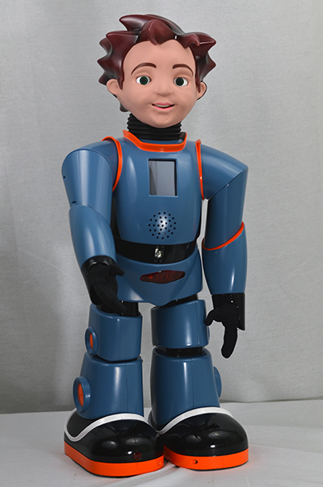
Milo
Milo can sense when a child begins to get frustrated or agitated and can react accordingly.
Is made partially of plastic and is 2 feet tall
Proving more successful than human therapists
Speaks 20% slower than an average human
Offers a broad range of facial expressions
Displays less emotions
https://www.youtube.com/watch?v=Iz7ajAi4yQY

Slide 16
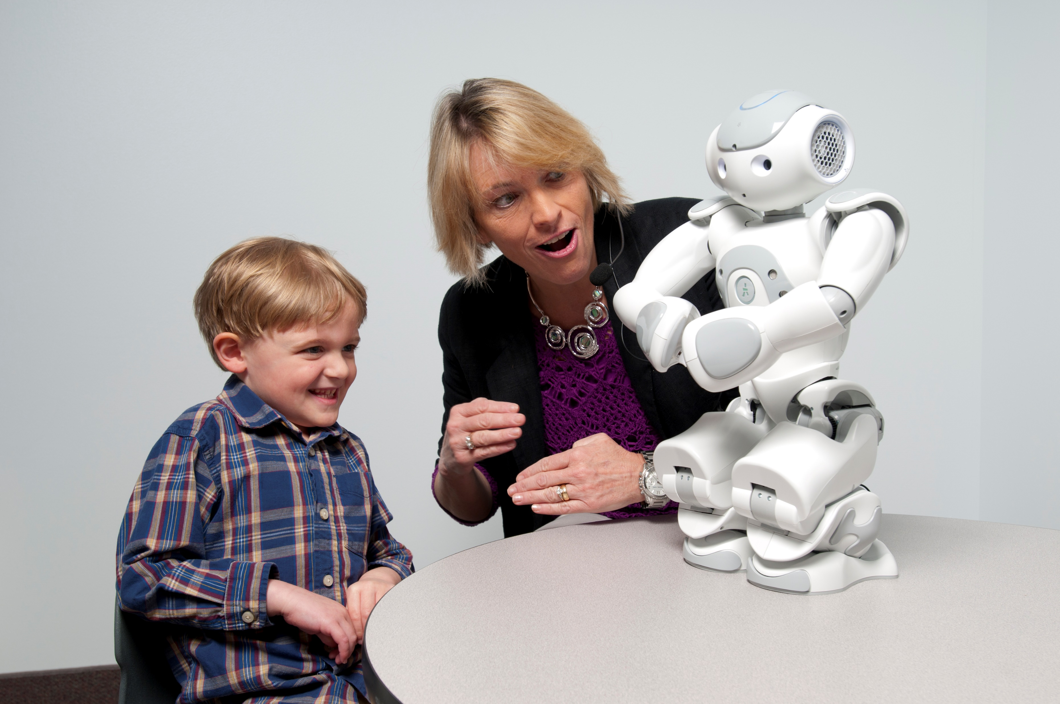

Slide 17
Can robots replace human therapists?
Robot-enhanced therapy ease the workload of human therapists
They can lower the cost of treatment
Can provide direct feedback to patients
Can interact with them on a regular basis
Helps improve the overall therapy process.
Robot-enhanced therapy is already yielding results

Slide 18
Can robots replace human therapists?
Which is the type of robot that will have long-term success with an autistic child?
Which is better? A simpler robot like Romibo or a more sophisticated device like the 23-inch-tall Nao?
Some children respond to social robots and others don‘t.
How well the learned skills translate to the real world?

